Slide 1
Lowering barriers to using computational notebooks
Tanaka Chitete
Bachelor of Science (Honours), Computer Science Dr. Rahul Gopinath
Lecturer, School of Computer Science
Notes:
Hi, my name is Tanaka Chitete and my research supervisor is Dr. Rahul Gopinath.
Today, I will be discussing my thesis, Lowering barriers to using computational notebooks.
Computational notebooks have revolutionised how data scientists, researchers, and educators engage with scientific computing. As their popularity has surged, so too has the realisation that the state-of-the-art is quite problematic, affecting a myriad of workflows.
In the first section, we will explore each of the problems that users face, from setup to deployment.

Slide 2
Problems
Setting up
Exploring and analysing data
Managing code
Ensuring reliability
Archiving
Securing
Sharing and collaborating
Reproducing and reusing
Deploying to production
Notes:
Setting up. Notebook users face problems as soon as they try to create a notebook. The process of importing and cleaning data often proves to be a clerical nightmare.
Exploring and analysing data. On many platforms, exploration and analysis seems incomplete. Users often find themselves stuck in an infinite loop of copying and pasting code to tweak visualisations.
Managing code. Despite representing the core workflow, writing and managing code is an ongoing frustration. Effective dependency management is difficult for users without software engineering backgrounds.
Ensuring reliability. Notebook execution can be quite unreliable and scaling to big data is generally unsupported. When handling big data, kernel crashes frequently occur, causing irreparable data inconsistencies.
Archiving. While many notebooks are typically used for “quick-and-dirty” work, others are authored with long-term usage in mind. However, most platforms don’t offer integrated versioning or search mechanisms.
Securing. Mitigating leaks of sensitive data and controlling notebook access are key security concerns. With a widespread lack in native security measures, users are forced to implement custom, often error-prone, processes.
Sharing and collaborating. Users seek to share notebooks interactively, statically, and as read-only files. They also wish to collaborate with real-time editing. However, sharing at any of these levels is generally unsupported and synced notebooks present coordination challenges.
Reproducing and reusing. Core tasks such as marking work or furthering research hinge upon reproducibility. Consequently, users want to adapt and reuse code to save time. Yet, reproducing computation or reusing code is often unfeasible.
Deploying to production. Although notebooks are suited to quick exploration and analysis, they are difficult to deploy. Their cell-based design represents an affront to software engineering best practices. As such, deployment often requires significant code refactoring and dependency packaging.

Slide 3
Background
Notes:
In this section, I will prescribe the background knowledge pertinent to this landscape.

Slide 4
Concepts
Computational notebook
Literate programming
Computational platform
Notes:
A computational notebook is a document used to encapsulate code, text and visualisations. This file is typically organised as a sequence of cells. The code cells, when executed, can display visualisations in adjacent output cells. Text cells, on the other hand, prescribe documentation.
Literate programming lies at the foundation. It is a paradigm that seeks to improve readability by considering programs to be "works of literature”. It authors a program as documentation of how it works, interspersing the program with snippets of executable code.
A computational platform is the underlying system that runs the notebook, providing the compute necessary to execute code.

Slide 5
Chronology
Notes:
In the next section, we will review some of the most significant contemporary platforms.

Slide 6
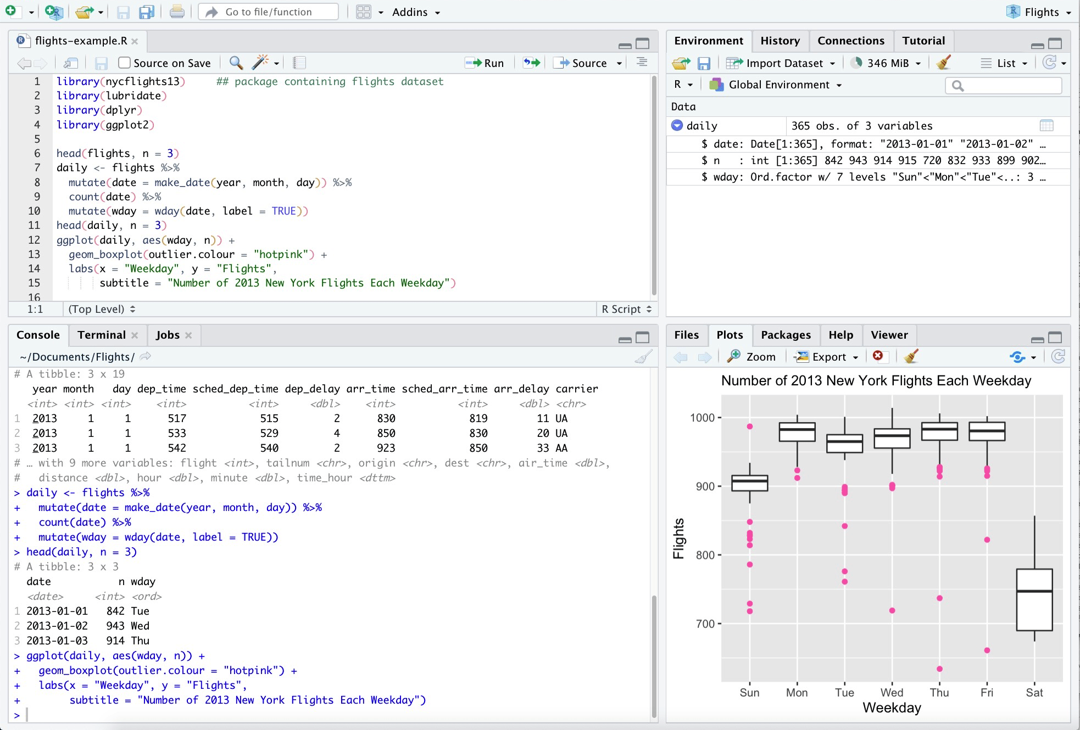
RStudio
Released in 2011 to offer a native platform for R
Integrates editor, plotting, console, and variable views
Features code-completion and syntax highlighting
Integrates R library-set
Provides Python interface
Notes:
RStudio is an open-source IDE for the R programming language. Announced in 2011, the IDE was fashioned to provide a streamlined environment for R-based workflows.
RStudio stands out for its seamless integration of numerous tools in one platform, encompassing a console, script editor, plot viewer, and package manager. The interface eases analysis with features like code-completion and syntax highlighting. RStudio even offers an interface for Python.

Slide 7
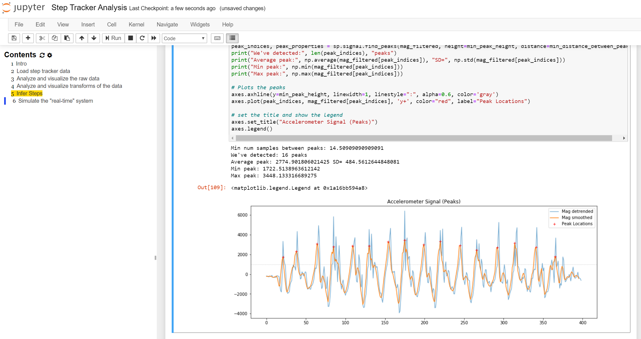
Jupyter Notebook
Unveiled in 2015 to offer a more versatile platform
Distinguished by its kernel-based architecture
Supports over 40 programming languages
Considering Python alone, supports all major packages
Notes:
Jupyter Notebook is perhaps the most prominent scientific computing platform. Launched in early 2015, it sought to offer a versatile platform for reproducible science across numerous domains.
Jupyter Notebook distinguishes itself with its kernel-based approach, supporting over 40 languages. Considering Python alone, Jupyter integrates with prominent data science packages.

Slide 8
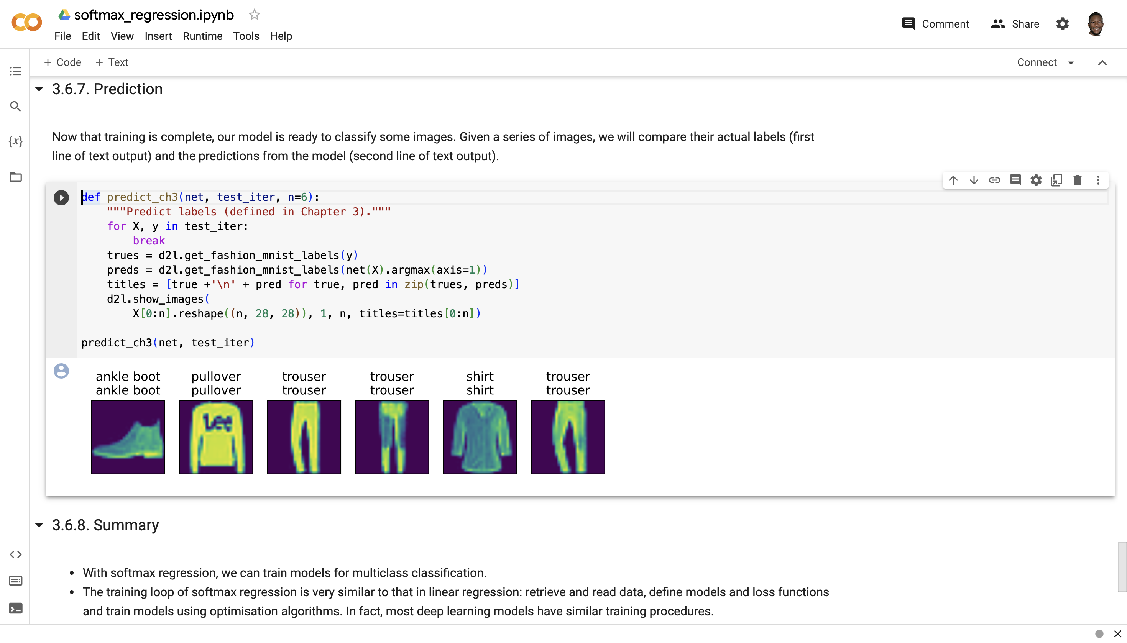
Colab
Launched in 2017 to enhance ML education
Based on Jupyter platform
Offers free GPU access
Supports Python, integrating major ML packages
Connects to Google Drive
Notes:
Colab is a Jupyter-based platform which provides free access to accelerated computing hardware. Google introduced Colab in 2017 to promote machine learning education, offering an accessible platform for experimentation and sharing.
Colab’s foremost feature is free GPU access, expediting machine learning. Despite Python remaining the solely supported language, the platform supports many of its major ML libraries. Furthermore, integration with Google Drive streamlines data sourcing.

Slide 9
Solution
Notes:
In this section, I will demonstrate Yuna’s capabilities and then we will delve into its implementation.

Slide 10
Demonstrating Yuna
https://tanaka-chitete.github.io/yuna/
Notes:
First, let’s take a look at Yuna in action.

Slide 11
Implementing the interface
CodeMirror supplies input cells
Bootstrap supplies toolbar, buttons, and styling
Notes:
Yuna provides Python and Markdown cells, facilitating code execution and rich-text documentation, respectively. These cells are provisioned by CodeMirror, an in-browser text editor solution.
Bootstrap, a prominent frontend framework, grants further aesthetic and functional enhancements.

Slide 12
Executing code
Pyodide powers code execution
Ports Python 3.11 runtime using Wasm
Loads runtime into the browser using JavaScript
Maintains standard library as a zip archive
Notes:
Code execution is driven by Pyodide, a Python distribution for the browser.
Pyodide ports the Python runtime using WebAssembly (Wasm), a binary execution format. The associated module is encapsulated within each environment.
Thereafter, Pyodide loads the runtime into the browser using JavaScript.
To incorporate the standard library, Pyodide maintains a zip archive. When loading the runtime, custom JavaScript imports the library into the runtime.

Slide 13
Loading packages
Custom Python script embeds requirements
micropip installs packages
Notes:
In the over-archiving Yuna ecosystem, a custom Python script is the primary utility used to construct each environment, embedding all requirements.
Package installation is achieved with micropip, a lightweight Python package manager for Pyodide.

Slide 14
Restoring sessions
cloudpickle serialises and deserialises all user-defined objects
Variables
Functions
Imports
Notes:
cloudpickle, a Python package for enhanced pickling support, is harnessed to ensure continuity of work. The entire session can be saved and restored with one click.

Slide 15
Parsing text
Marked powers rich-text documentation
Notes:
Marked, a JavaScript compiler for parsing markdown, powers rich-text documentation. It retrieves and translates Markdown syntax into HTML syntax, immediately rendering documentation in the browser.

Slide 16
Evaluation
Notes:
In this section, we will examine how well Yuna solves existing problems.

Slide 17
Managing code – Managing dependencies
Installing, updating, and handling packages
Platforms should offer integrated dependency management
Yuna embeds all dependencies within the file, fully automating dependency management
Notes:
A computational platform should offer integrated package management. It should offer capabilities such as seamless discovery, installation, updating, and deprecation-handling. These capabilities should be provisioned directly within the interface, obviating command-line interventions.
Yuna embeds all dependencies within the file, fully automating dependency management.

Slide 18
Ensuring reliability – Executing
Running code, either select cells or the entire notebook
Platforms must ensure execution is constantly-available
Yuna embeds both the kernel and parser within each environment, guaranteeing availability
An environment can be as small as 27 MB
Notes:
Computational platforms must offer persistent kernel connectivity. Realtime execution monitoring, automatic state recovery, and transparency in kernel activities are further enhancements.
Yuna embeds both the kernel and parser within each environment, guaranteeing availability. Notably, even with a fully self-contained architecture, a Yuna environment can be as small as 27 MB.

Slide 19
Archiving – Versioning
Tracking changes to source code files
Notebooks rely on a wide range of artefacts
Platforms must offer an integrated version control mechanism
Yuna embeds the notebook, data, packages, and compute within each environment
Notes:
To address versioning, the essential capability is an integrated version control mechanism. This mechanism must capture notebook contents and session data.
To this end, Yuna embeds the notebook, data, packages, and compute within each environment, allowing for easy versioning.

Slide 20
Sharing and collaborating – Sharing the notebook
Making the notebook accessible to others
If sharing interactively is infeasible, platforms should offer cell-collapsing, exporting, and comment-only viewing
Yuna embeds the notebook and platform within each environment
Notes:
If sharing the notebook is infeasible, computational platforms should offer features such as:
- Cell-collapsing, for visualisation emphasis
- Exporting to a diverse set of formats, such as presentations
- Comment-only modes for feedback without execution
Yuna embeds the notebook and platform within each environment, allowing for easy sharing.

Slide 21
Sharing and collaborating – Sharing related artefacts
Making the associated session, data and packages available
Platforms should provide integrated artefact packaging
Yuna embeds both data and packages within each environment
Notes:
Computational platforms should provide integrated data- and environment-packaging, ensuring recipients can reproduce computation without manual setup. Importantly, the platform must do so while preserving the notebook’s "single file" paradigm.
Yuna embeds both data and packages within each environment, allowing for easy sharing

Slide 22
Reproducing and reusing – Reproducing
Reproducibility is the ability to consistently replicate results
Platforms should be designed to inherently support reproducibility
Yuna embeds all artefacts within each environment file
Notes:
Reproducibility refers to the ability to consistently recreate computational results. Consequently, the baseline is the ability to completely reproduce computation, replicating the session, data, and packages.
Yuna embeds all artefacts within each environment, guaranteeing reproducibility.

Slide 23
Reproducing and reusing – Reusing and adapting
Leveraging prior code for use in differing contexts
Platforms should provide integrated dependency management
By embedding dependencies within each environment, Yuna allows the user to simply copy the file
Notes:
To address challenges relating to reuse and adaptation, platforms should offer standardised modular cells, resolve small-scale logic discrepancies, or provide automated dependency management.
By embedding dependencies within each environment, Yuna allows the user to simply duplicate it if reuse and adaptation is necessary.

Slide 24
Discussion
Notes:
In this section, we will spotlight limitations I encountered in Yuna’s development. These limitations offer insights into potential areas for future work.

Slide 25
Future work
Loading data
Usability testing
Serialising
Visualising
Minimising file sizes
Maintaining software
Exporting contents
Notes:
Loading data. Yuna currently does not facilitate the direct loading of local data. Future versions will integrate the File System API to meet this end.
Usability testing. Yuna’s development phase lacked structured usability testing. Comprehensive usability studies will be conducted to assess Yuna’s user experience. These studies will help gather user feedback in real-world scenarios, enabling the development of more intuitive features.
Serialising. For object serialisation, dill is the state-of-the-art—offering advanced functionalities such as saving an entire session. Unfortunately, dill is not currently supported by Pyodide. Upon its availability, it will be integrated into Yuna.
Visualising. At the time of submitting my thesis, Yuna did not support visualisation. As of a few days ago, static visualisation was achieved. Future efforts will entail the development of an interactive visualisation component.
Minimising environment sizes. Remarkably, an entire environment can be encapsulated within a file as small as 27 MB. Environments embedded with multiple packages, however, can be excessively large, easily exceeding 100 MB. Various encodings will be explored to reduce file sizes.
Maintaining software. The manual embedding each software component has introduced significantly complicated updates and maintenance. Automating the embedding process of core software components will be a key focus.
Exporting. Yuna currently lacks the ability to export notebook contents to varied formats. Adding the ability to export notebooks is planned.

Slide 26
Conclusion
Notes:
In the last section, I will conclude this presentation by discussing the contributions made in our research.

Slide 27
Contributions
Compendium of domain knowledge
19-point chronology of the most significant platforms
Yuna, a fully self-contained platform, soothing:
Managing code
Ensuring reliability
Archiving
Sharing and collaborating
Reproducing and reusing
Technical evaluation of 13 state-of-the-art platforms
Notes:
Our contributions are multi-fold:
We author a compendium of knowledge not only pertinent to the wider landscape of computational platforms
We compile a 19-point chronology of the most significant historical and contemporary platforms, charting the evolution of the landscape
We present Yuna, a fully self-contained computational notebook platform, lowering barriers to entry by soothing the following pain points:
Managing code
Ensuring reliability
Archiving
Sharing and collaborating
Reproducing and reusing
We technically evaluate 13 state-of-the-art platforms against all 9 pain points and their underlying activities, totalling 22.

Slide 28
Summary
Notes:
Thank you for listening to my presentation!

Slide 29
References
Aashita. 2023. Beginners Guide to Databricks: Batch Processing and Streaming. Databricks.
cdhowe. 2021. The RStudio IDE is a free and open source integrated development environment (IDE) for R. It helps programmers develop software written in R, Python, and several other languages. Wikimedia Commons.
Souti Chattopadhyay, Ishita Prasad, Austin Z. Henley, Anita Sarma, and Titus Barik. 2020. What’s wrong with computational
notebooks. In Proceedings: 2020 Conference on Human Factors in Computing Systems.
Databricks. 2022. Databricks | Notebook Development Overview. YouTube.
Databricks. 2023a. Collaborate using Databricks notebooks. Databricks.
Databricks. 2023b. Databricks for Python developers. Databricks.
Databricks. 2023c. Databricks for R developers. Databricks.
Databricks. 2023d. Databricks for Scala developers. Databricks.
Databricks. 2023e. MLflow guide. Databricks.
Databricks. 2023f. SQL language reference. Databricks.
Databricks. 2023g. TensorBoard. Databricks.
Databricks. 2023h. What is Delta Lake? Databricks.
Databricks. n.d.a. Databricks is the data and AI company. Databricks.
Databricks. n.d.b. The best data platform is a lakehouse. Databricks.
Dave Gershgorn. 2017. Nerds rejoice: Google just released its internal tool to collaborate on AI. Quartz.

Slide 30
References
Google. n.d. Welcome to Colab! Google.
Donald Knuth. 1984. Literate Programming. The Computer Journal.
Makeability Lab. n.d. Jupyter Notebook showing visualization of a 3-axis accelerometer to infer step counts. Makeability Lab.
Matplotlib. n.d. Image tutorial. Matplotlib.
Microsoft. 2023a. Train TensorFlow models at scale with Azure Machine Learning. Microsoft.
Microsoft. 2023b. Train PyTorch models at scale with Azure Machine Learning. Microsoft.
Microsoft. n.d. Azure Machine Learning. Microsoft.
Ron Miller. 2015. Microsoft Officially Launches Azure Machine Learning Platform. TechCrunch.
NumPy. n.d. NumPy: The Absolute Basics for Beginners. NumPy.
pandas. n.d. Intro to Data Structures. pandas.
Fernando Perez. 2014. Project Jupyter. Speaker Deck.
Project Jupyter. n.d. Jupyter: Free software, open standards, and web services for interactive computing across all programming languages. Project Jupyter.
RStudio. n.d.a. Python. RStudio.
RStudio. n.d.b. RStudio Open-Source Packages. RStudio.
RStudio Team. 2011. RStudio, a new open-source IDE for R. Posit Software.
Kevin Ushey. 2023. Code Completion in the RStudio IDE. Posit Support.

